Slide 1
L7 firewall component

Slide 2
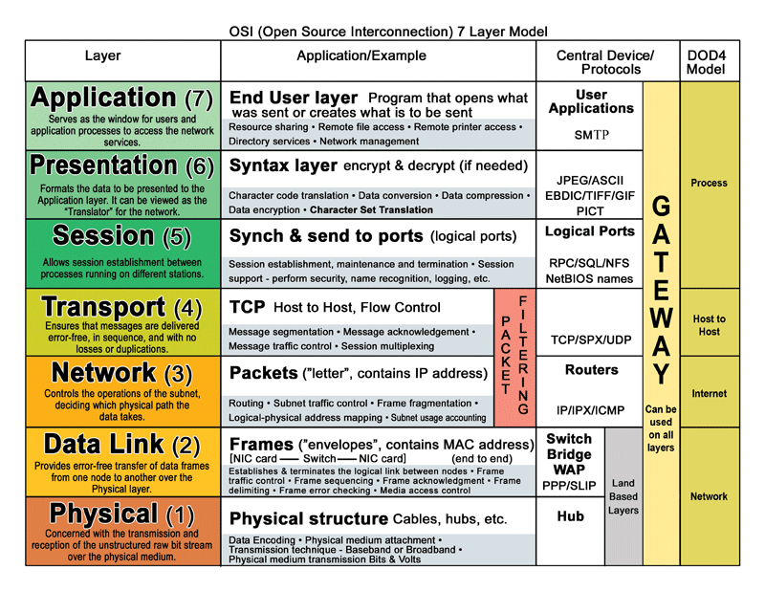
Layer 7

Slide 3
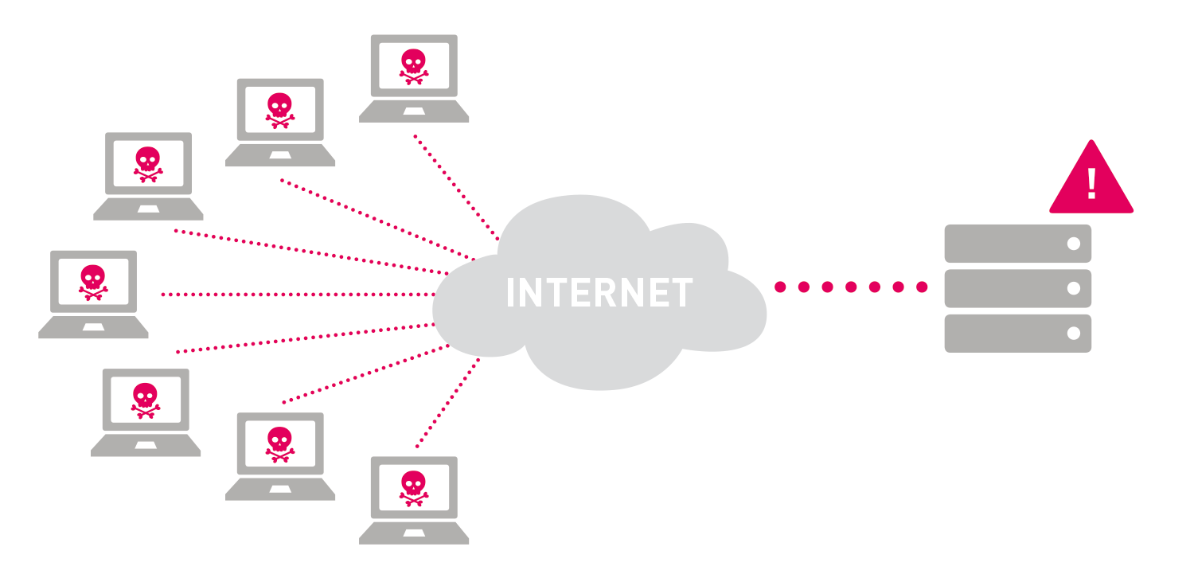
Premise and need

Slide 4
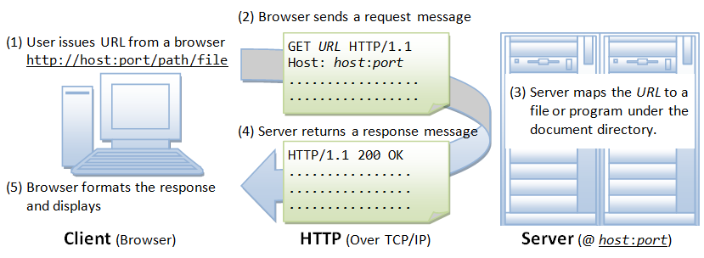
HTTP GET

Slide 5
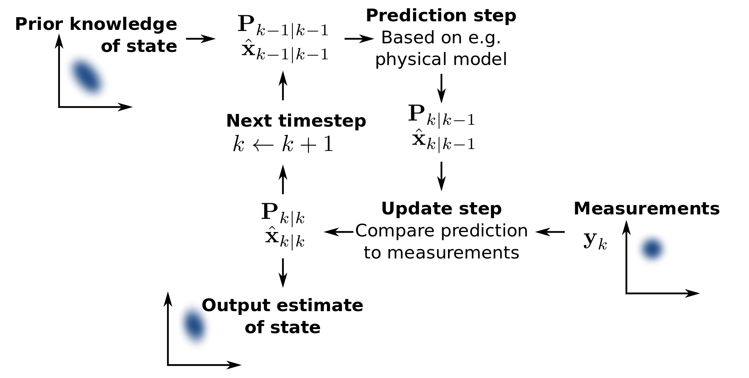
Kalman filter

Slide 6
Entropy
Interval of 0.1 seconds:
IP1 : count of requests from IP1
IP2 : count of requests from IP2
.
.
.
IPn : count of requests from IPn
In program, dictionary for every interval
unix time ⋅ 10
xxxxxxxxxx1
xxxxxxxxxx2

Slide 7
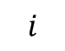

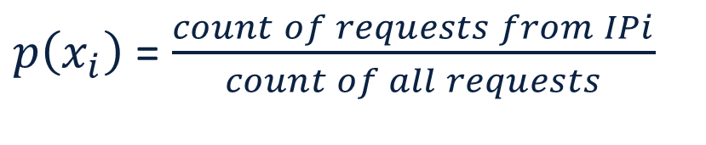
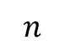
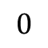
Entropy
index
$$0$$
IP1 : count of requests from IP1
IP2 : count of requests from IP2
.
.
.
IPn : count of requests from IPn
$$i$$
$$n$$
HRPI $=\sum_{i=0}^{n}{−p\left(x_{i}\right)∙\log_{2}p\left(x_{i}\right)}$
$p\left(x_{i}\right)$ = $\frac{count of requests from IPi}{count of all requests}$

Slide 8
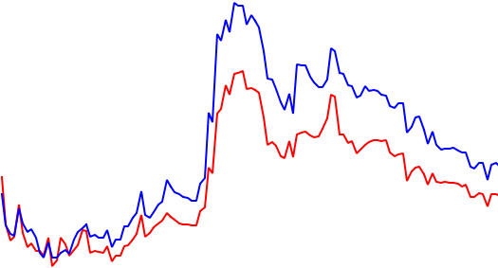
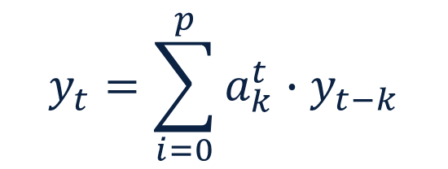
Autoregression
fitted value
measured value
$$y_{t}=\sum_{i=0}^{p}{a_{k}^{t}∙y_{t−k}}$$

Slide 9
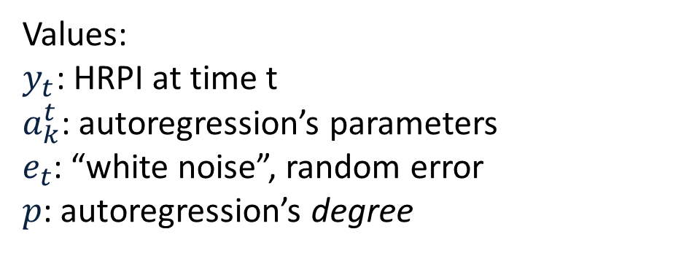
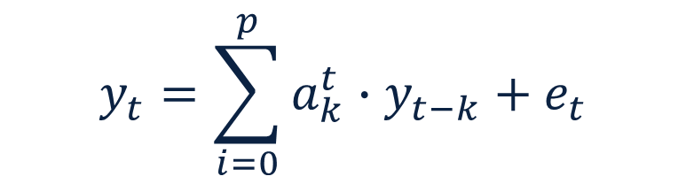
Autoregression
$$y_{t}=\sum_{i=0}^{p}{a_{k}^{t}∙y_{t−k}+e_{t}}$$
Values:
$y_{t}$: HRPI at time t
$a_{k}^{t}$: autoregression’s parameters
$e_{t}$: “white noise”, random error
$p$: autoregression’s degree

Slide 10

Autoregression
Transformed into matrix form:
$$Y_{t}=X_{t}{ Y}_{t(−p)}+e_{t}$$
“state” vector
Scientists noticed, that the “state” vector, which can be approximated by Kalman filter, describes the state of the traffic very well.

Slide 11

Basic idea of traffic state prediction
3 last entropy values + current one
Kalman filter
3 AR parameters
Support vector
machine
0/1: normal/attack traffic

Slide 12



DDOS generation
Script which generates HTTP GET requests from configurable number of IP addresses
Generate attacks with varying request rate
Receive requests from set of IPs
Invoke proxy chains

Slide 13
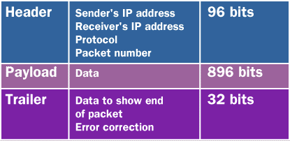


Packet extraction
{ }:
sniff()
Scappy API
Packet #n:
Item #1: IP
Item #2: IP
append to queue
{ }:
extraction and aggregation
process-safe queue

Slide 14




Multiprocess queue
Producer: put requests from NIC
Put results to database
Consumer: take requests in interval, calculate HRPI, predict state

Slide 15
Support vector machine
Radial basis kernel function
Trained on 52k. example points
Primary data: 7.2 GB packets (40%-60% attack traffic – normal traffic)
Primary fit: 98.87 %
Independent test on 48k. example points
Primary data: 4.4 GB packets (40%-60% attack traffic – normal traffic)
Single batch score: 92.27 %

Slide 16
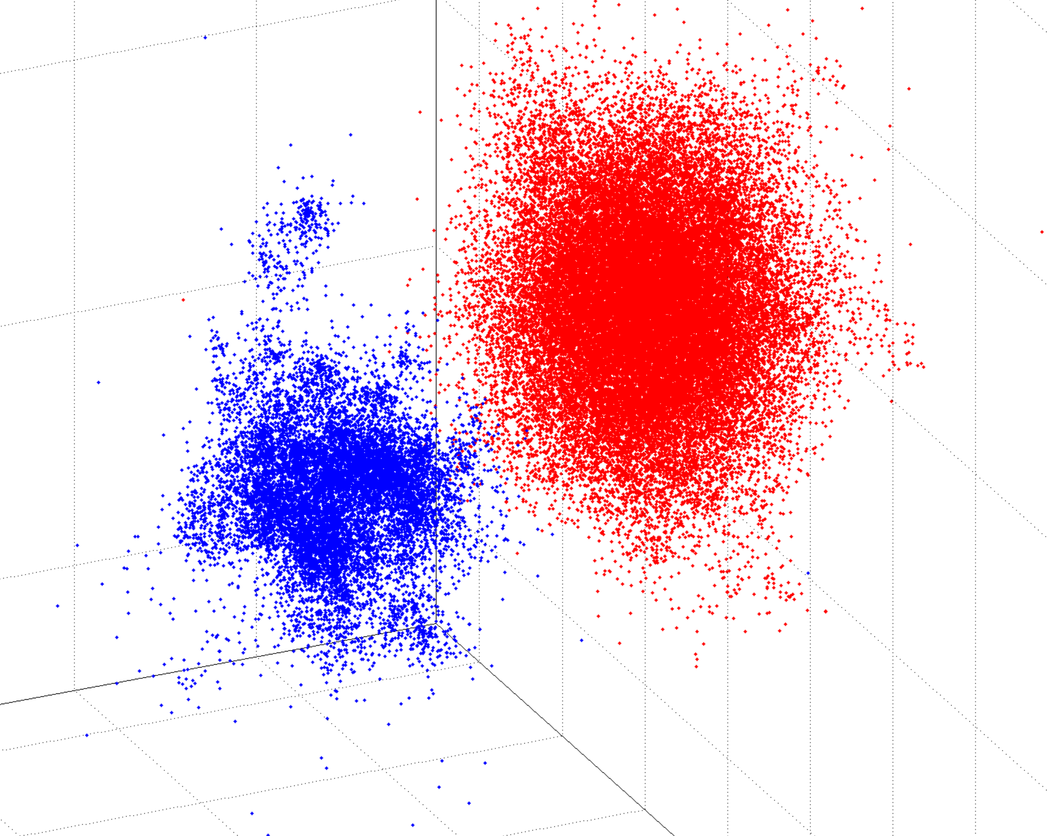
Training entropy parameters
normal state
attack state

Slide 17
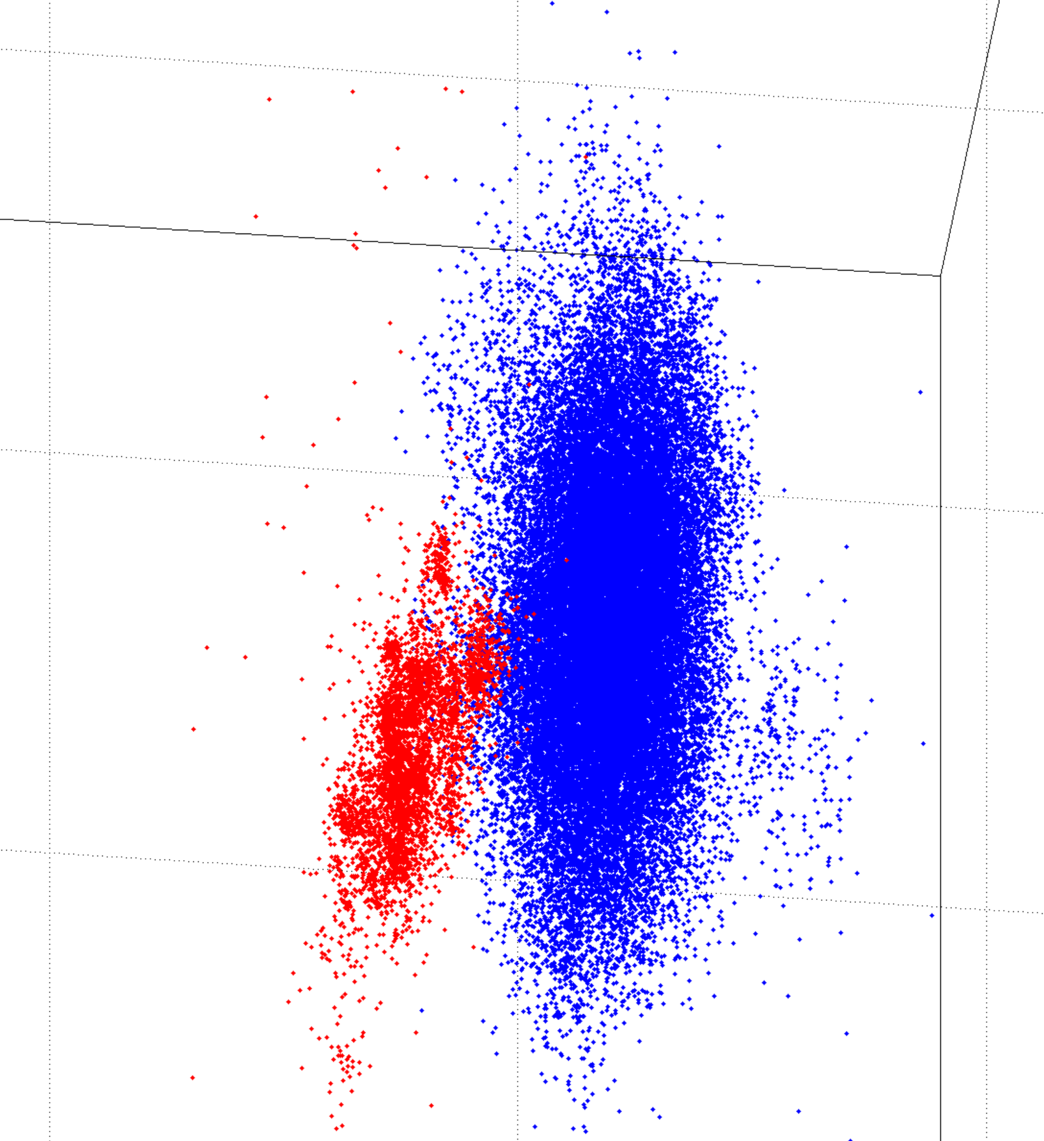
Testing entropy parameters
normal state
attack state

Slide 18
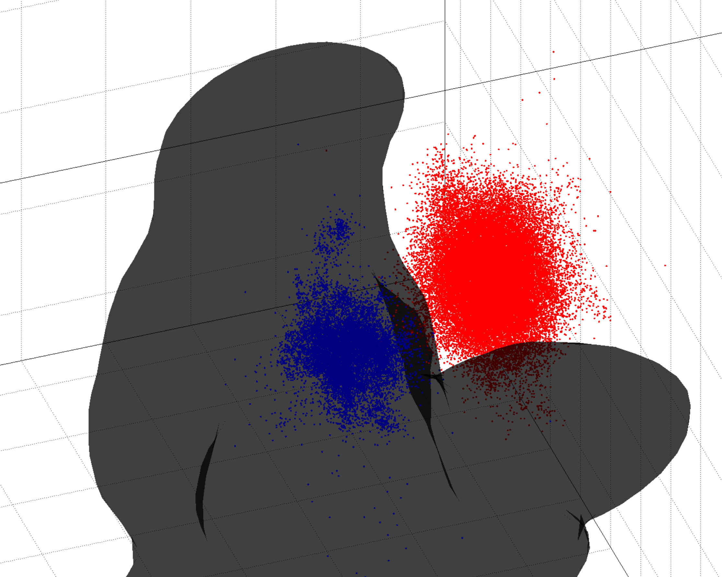
Trained SVM
normal state
attack state
hyperplane

Slide 19
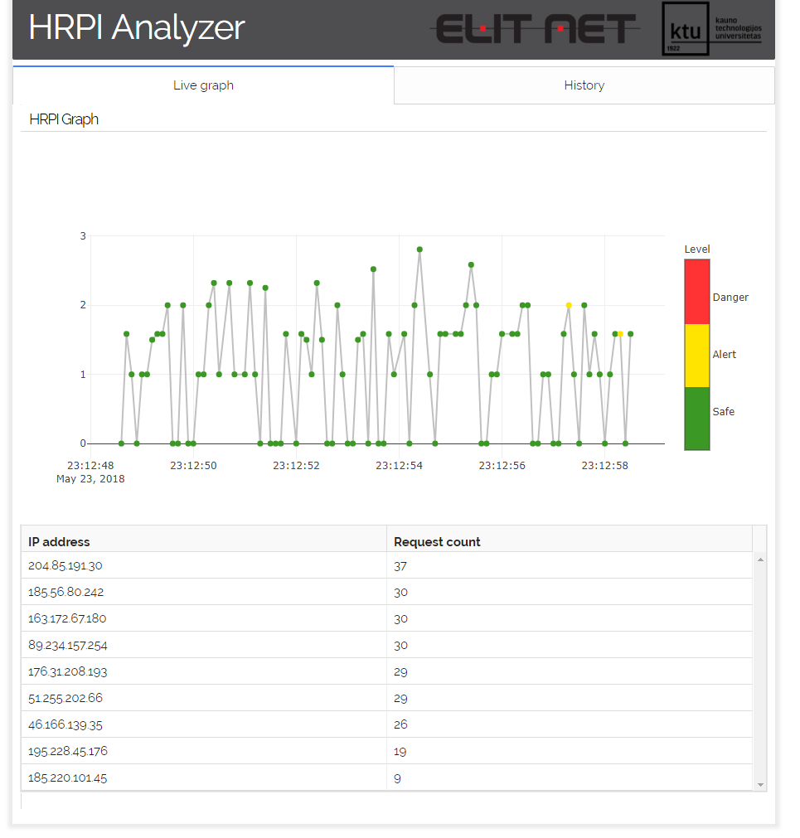
Graphical user interface
Tabs for live and history views
Live graph area
Color legend of traffic state points
HRPI entropy scale
Timestamps
IP requests active in current framework

Slide 20
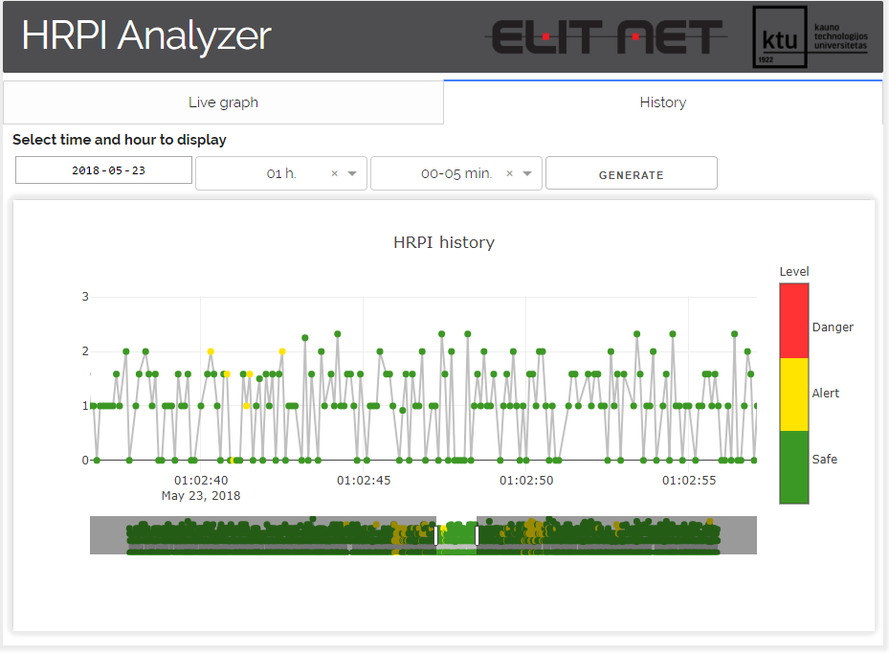
Graphical user interface
Date, hour, 5-minute interval selection
Button to generate history of the given interval
Slider to expand data series

Slide 21
The end

